Slide 1
Compression
Shock and Vibration

Slide 2
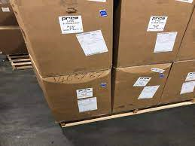
Compression damage
https://www.youtube.com/watch?v=dYGZYvspfpg

Slide 3
Contribution from Contents
Do contents support weight
Where do they support the weight
Where contents make a partial contribution the maximum contribution from the contents and the pack should occur at the same point

Slide 4
Compressive Strength (Corrugated Cases)
Test Method
Static or Dynamic
Fixed or Floating Platen
Humidity
Stacking Pattern
Compressive History
Time

Slide 5
Stacking Factors
Stacking Factors can be used to estimate the compressive strength required from a case
Calculate the required compressive strength by determining the load the case has to hold and multiply by the stacking factor.

Slide 6
Stacking Factors

Slide 7
McKee Formula
C= 5.87 P_{m}(h x Z)^{0.5}
C= Top to Bottom Compression strength
P_{m}=Edge Crush resistance
h=Box Height
Z=Box Perimeter

